Slide 1

NEIU Center for Teaching & Learning
Using the LMS to Increase Student Retention: D2L Tools & Analysis

Slide 2

View User Progress

Slide 3
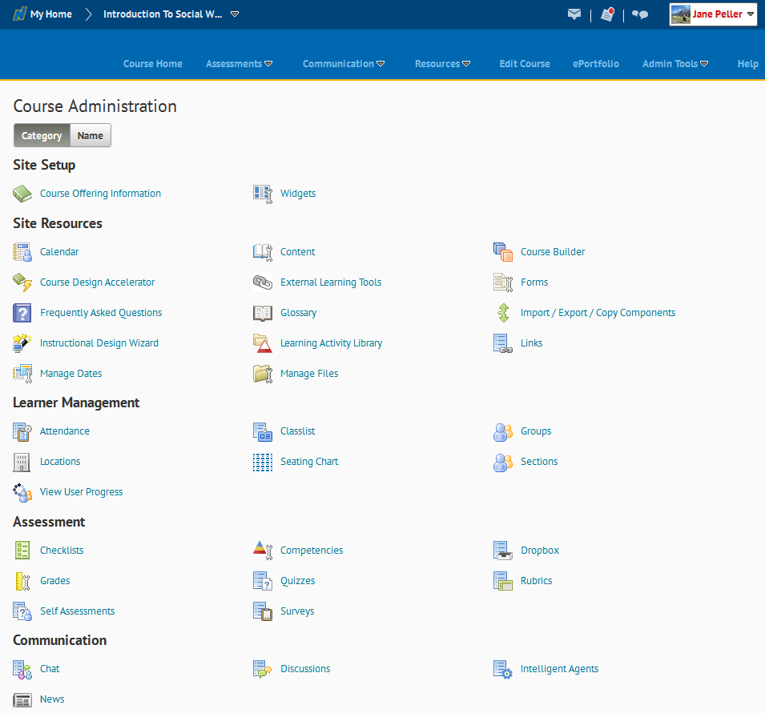
Course Administration Screen: View User Progress
VIEW USER PROGRESS
Notes:
Show participants where the View User Progress link is.
Ask them to click into the View User Progress tool.

Slide 4
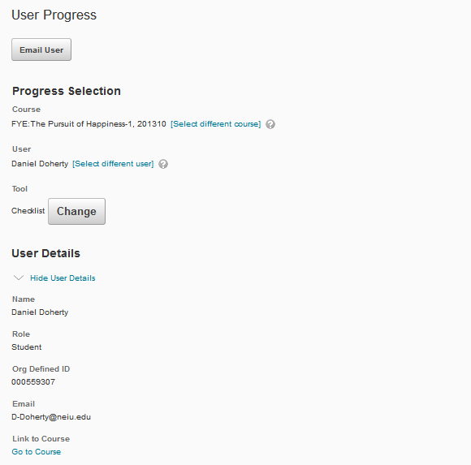
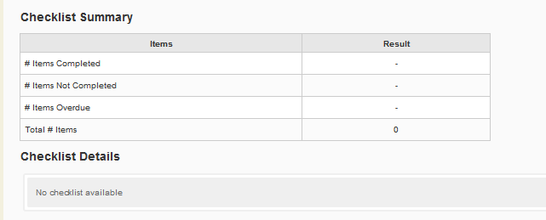
View User Progress Screen
PRINTABLE CONTENT GUIDE: http://www.neiu.edu/~ctl/D2L/D2L View User Progress.pdf
Notes:
Tell Participants to watch you demonstrate this feature (they will not have any users yet).
Make sure you are in an active course with active students in order to demonstrate this feature.
Explain that the User Progress screen initially displays the first student in the course; use the [Select different user] link to see course progress for other students.
Select the Change button and select Content and then the Apply button.
Explain the various other types of statistics that can be seen using the View User Progress tool.
Ask participants to click the Course Home link in the navigation area.

Slide 5
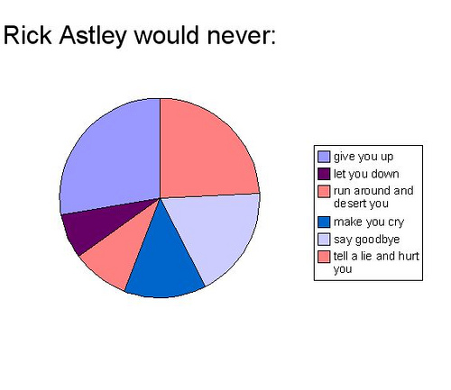
Rubric Analysis

Slide 6
Rubric Analysis
Benefit to instructors who use the D2L Rubrics.
Allows instructors to view various levels of statistics.
Helpful during the course and departmental assessment process.

Slide 7
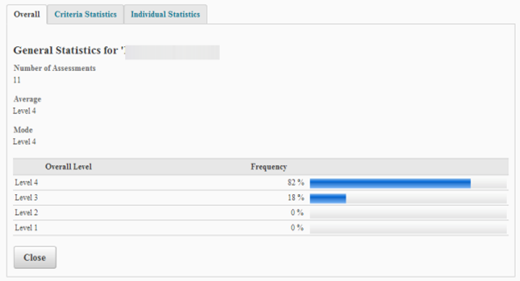
Rubric Analysis
Overall Statistics

Slide 8
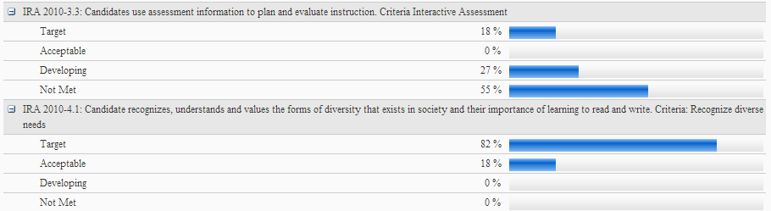
Rubric Analysis
Criteria Statistics

Slide 9
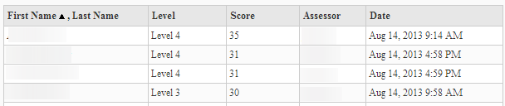
Rubric Analysis
Individual Statistics

Slide 10

Intelligent Agents

Slide 11
Course Administration Screen: Intelligent Agents
INTELLIGENT AGENTS
Notes:
Show participants where the Intelligent Agents link is.
Ask them to click into the Intelligent Agents tool.

Slide 12
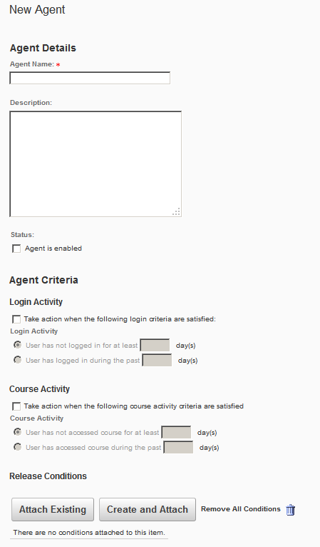
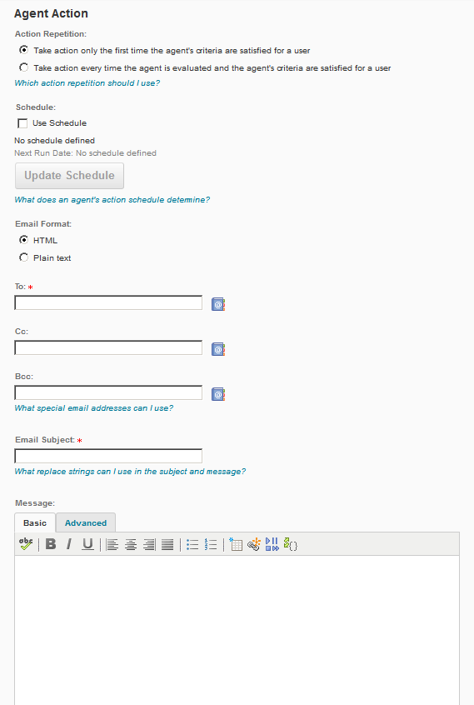
Intelligent Agents Screen
PRINTABLE CONTENT GUIDE: http://www.neiu.edu/~ctl/D2L/D2L Intelligent Agents Guide.pdf
Notes:
Walk participants through the process of creating a New Intelligent Agent.
Explain that Intelligent Agents reach out to students automatically if they have not logged in, not come into the course, or not met another condition that the instructor can set (e.g., hasn’t viewed the syllabus, hasn’t taken part in the unit discussion, or hasn’t submitted to a given Dropbox).
Click the New button.
Result: The New Agent screen displays.
Key an Agent Name.
Option: Key a Description for the Intelligent Agent.
Option: Select the Agent is enabled check box if you want the agent enabled once you save.
In the Agent Criteria fields, determine the criteria the agent looks for:
a. Login Activity: Select the Take action when the following login criteria are satisfied check box and choose which of the two login activities you want to monitor.
b. Course Activity: Select the Take action when the following course activity criteria are satisfied check box and choose which of the two course-activity functions you want to monitor.
c. Release Conditions: Click the Attach Existing or Create and Attach button to select or create release conditions for the agent to monitor.
In the Agent Action fields, determine the action the agent takes when its conditions are met. Select one of the Action Repetition options to set whether the agent takes action once or any time the conditions are met.
Option: Select the Use Schedule check box, then click the Update Schedule button.
Result: The Update Agent Schedule dialog box displays.
a. Set the schedule options.
b. Click the Update button.
Result: The New Agent screen displays.
Select HTML or Plain Text for the E-mail Format.
Key the names of recipients in the To, Cc, and Bcc fields.
Option: Use special “replace strings” in these fields, such as the one below.
{InitiatingUser} – The user who performs the actions necessary to satisfy the agent's criteria.
Enter an E-mail Subject.
Option: You can use special “replace strings” in this field, such as the ones below.
{OrgUnitName} - The name of the course/section.
{InitiatingUserFirstName} - The first name of the initiating user.
{InitiatingUserLastName} - The last name of the initiating user.
Enter a Message.
Click the Save and Close button.
Ask participants to click the Edit Course link in the navigation bar to continue to the next topic.

Slide 13
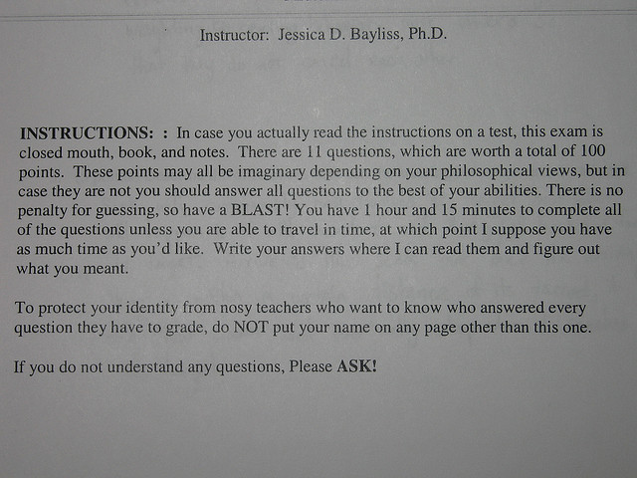
Quiz Analysis

Slide 14
Quiz Analysis
Benefit to instructors who use D2L Quizzes.
Helps instructors view similar statistics as ScanTron reports along with other helpful statistics.
Helpful during the course and departmental assessment process.

Slide 15
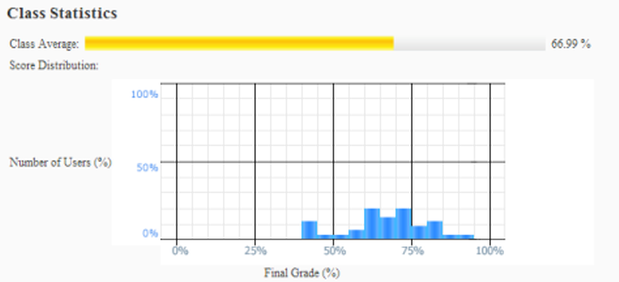
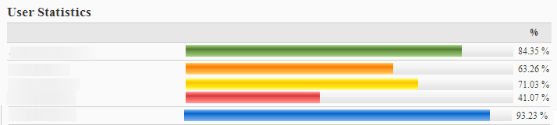
Quiz Analysis
Class & User Statistics

Slide 16
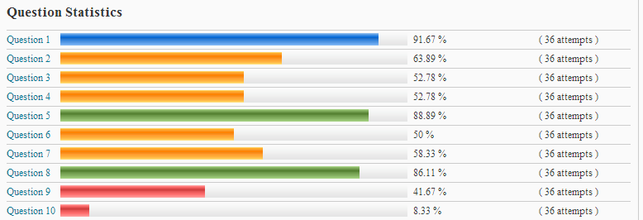
Quiz Analysis
Question Statistics

Slide 17
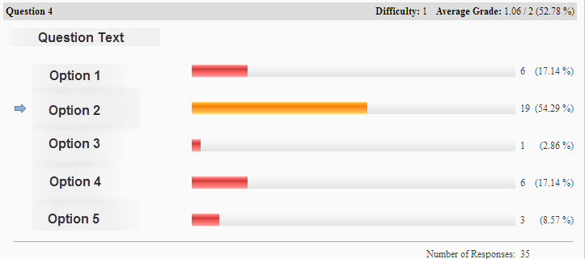
Quiz Analysis
Question Details

Slide 18
NEIU Center for Teaching & Learning
http://www.neiu.edu/~ctl/
THANK YOU!

